Slide 1
Flow: A mindful edge in performance
Sue Jackson, PhD

Slide 2
My Background
Psychologist (positive & performance psych):
  QUT Counselling Services
  Training in ACT
  Mindfulness-meditation workshops & courses
Yoga Teacher
Researcher of Flow State
  PhD on flow experience in elite athletes
  Developed self-report scales to assess flow
  Author of flow publications

Slide 3
Mindfulness
Present-centered focus
Total task engagement
Awareness
Pathway to Flow

Slide 4
Flow
an optimal psychological state (Csikszentmihalyi)
a state of total focus on the task at hand; being in the present moment
associated with positive experiences and performance outcomes

Slide 5


Slide 6
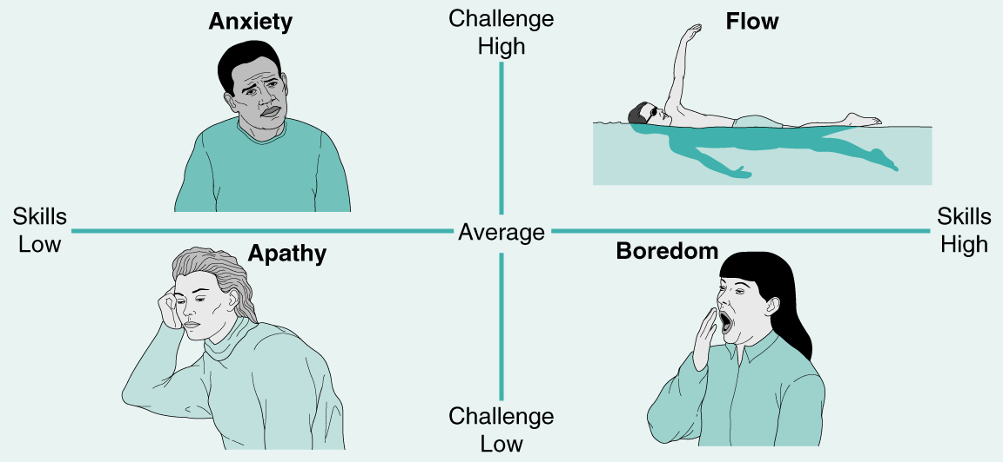
The Flow Model

Slide 7

Enhancing Flow, Enhancing Experience

Slide 8
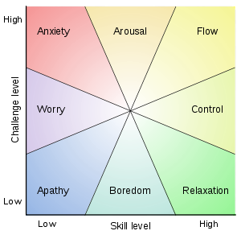

Slide 9
Dimensions of Flow
Challenge-skill Balance
Action Awareness Merging
Clear Goals
Unambiguous Feedback
Total Concentration
Sense of Control
Loss of Self-Consciousness
Time Transformation
Autotelic Experience

Slide 10
Flow ←→ Mindfulness
FLOW: Total focus on task at hand
  Positive psychology concept dating back to 1970s
  Clear conceptual model
  Strong research base
  Strong anecdotal support
  A learned experience
MINDFULNESS: Awareness to one’s here-and-now experience
  Embraced by psychology (1970s) following long history in spiritual & yoga traditions
  Clear conceptual models
  Strong research base
  Strong anecdotal support
  A learned experience

Slide 11
Being Present
“If you are interested in something, you will focus on it, and if you focus attention on anything, it is likely that you will become interested in it. Many of the things we find interesting are not so by nature, but because we took the trouble of paying attention to them.”
- Mihaly Csiksentmihalyi

Slide 12
The power of moving forward confidently in direction of what matters. . .
If one advances confidently in the direction of one’s dreams and endeavours, to live the life they have imagined, they will meet with success unexpected in common hours.
- Thoreau (1800s)

Slide 13
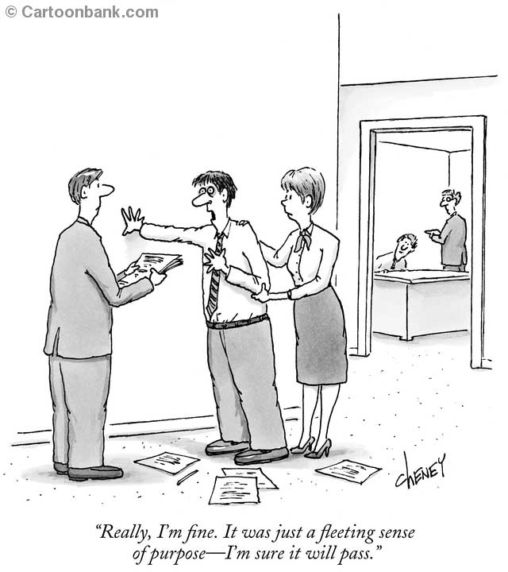

Slide 14
Factors Found to Influence Flow in elite sport Jackson (1995)
Motivation
Arousal/energy level
Planning (pre & for during event)
Physical readiness
Environmental & situational conditions
How performance feels & progresses
Focus
Confidence & mental attitude
Team/group dynamics
Prior experience

Slide 15
Psychological Antecedents to Flow in Sport & Related Settings
Perceived ability/confidence/self-concept
  Jackson et al. 1998; 2001; Koehn et al., 2005
Anxiety (-ve relationship)
  Jackson et al., 1998; Koehn et al., 2005; Wiggins & Freeman, 2000
Intrinsic Motivation
  Jackson et al., 1998; Kowal & Fortier, 1999
Psychological skills
  Jackson et al., 2001-negative thinking (-ve), activation, emotional control, relaxation,
  Koehn et al, 2005—imagery
Perfectionism (-ve relationship)
  Vea & Pensgaard, 2004
Music, Hypnosis (as interventions)
  Pates et al., 2000; 2001; 2002; 2003

Slide 16
3 key pre-conditions for Flow:
Challenge-skill balance
Clear goals
Feedback

Slide 17
A mindset that facilitates flow
Identify what is important
Move in the direction of what is important, taking into account feedback along the way
Embrace challenge
Stay in the present moment

Slide 18
Being Mindful, Experiencing Flow
Being aware of, and accepting of our experience, and staying in the present, creates a mindset that facilitates flow
Creating an environment of appropriate challenge-skill balance, & tuning in to feedback, will enhance the potential for being mindful and experiencing flow

Slide 19
The Power of the Present
When you surrender to what is, and so become fully present, the past ceases to have any power. You do not need it anymore. Presence is the key. The Now is the key.
- Ekhart Tolle (2004)

Slide 20
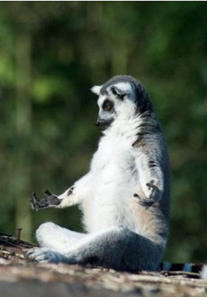
Don’t put the key to your happiness in someone else’s pocket.

Slide 21
References & Resources
Csikszentmihalyi, M. (1975). Beyond boredom & anxiety.
Csikszentmihalyi, M. (1990). Flow.
Jackson, S.A., & Csikszentmihalyi, M. (1999). Flow in Sports. Human Kinetics.
Tolle, E. (2004). The Power of Now.

